Slide 1
Lecture 8 Code Refactoring
Dr. Hesam Chiniforoshan
se.usc.ac.ir@gmail.com

Slide 2
What is Code Refactoring
“... Process of changing a software system in such a way that it does not alter the external behaviour of the code yet improves its internal structure.” – Folwer.
Simply put, it is just cleaning up your code
2

Slide 3
Refactoring
Basic metaphor:
Start with an existing code base and make it better.
Change the internal structure while preserving the overall semantics
i.e., rearrange the “factors” but end up with the same final “product”
The idea is that you should improve the code in some significant way. For example:
Reducing near-duplicate code
Improved cohesion, lessened coupling
Improved parameterization, understandability, maintainability, flexibility, abstraction, efficiency, etc …

Slide 4
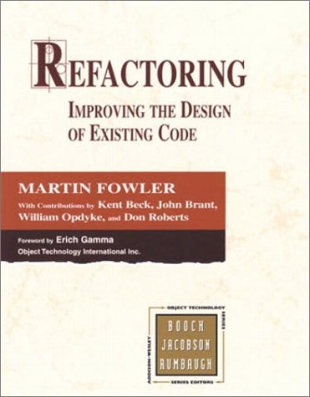
Refactoring
Reference:
Refactoring: Improving the Design of Existing Code,
by Martin Fowler (et al.),1999, Addison-Wesley
Fowler, Beck, et al. are big wheels in the OOA&D crowds
Smalltalk experience
OO design patterns
XP (extreme programming)
Book is very good
Ideas have been around for a long time tho.
Experienced OO programmers will have a pretty good handle on most of the ideas
Mostly it’s a catalogue of transformations that you can perform on your code, with motivation, explanation, variations, and examples
e.g., Extract Interface, Move Method, Extract Class

Slide 5
Refactoring
Book has a catalogue of:
22 “bad smells in code”
i.e., things to look out for, “anti-patterns”
This font and colour indicates the name of a bad smell.
72 “refactorings”
i.e., what to do when you find them
This font and colour indicates the name of a refactoring.
We will look at some of the bad smells and what to do about them.

Slide 6
Some advice from Fowler
“When should I refactor? How often?
How much time should I dedicate to it?”
It’s not something you should dedicate two weeks for every six months …
… rather, you should do it as you develop!
Refactor when you recognize a warning sign (a “bad smell”) and know what to do
… when you add a function
Likely it’s not an island unto itself
… when you fix a bug
Is the bug symptomatic of a design flaw?
… when you do a code review
A good excuse to re-evaluate your designs, share opinions.

Slide 7
XP and Refactoring
Simple design – system is designed as simply as possible (extra complexity removed as soon as found)
Refactoring – programmers continuously restructure the system without changing its behavior to remove duplication and simplify
Any programming construct can be made more abstract … but that’s not necessarily a good thing.
Generality (flexibility) costs too
Don’t spin your wheels designing and coding the most abstract system you can imagine.
Practise Just-in-Time abstraction.
Expect that you will be re-arranging your code constantly. Don’t worry about it. Embrace it.

Slide 8
Bad smells in code
Speculative Generality
Temporary Field
Message Chains
Middle Man
Inappropriate Intimacy
Alternative Classes with Different Interfaces
Incomplete Library Class
Data Class
Refused Bequest
Comments
Duplicated Code
Long Method
Large Class
Long Parameter List
Divergent Change
Shotgun Surgery
Feature Envy
Data Clumps
Primitive Obsession
Switch Statements
Parallel Inheritance Hierarchies
Lazy Class

Slide 9
Bad smells in code
Duplicated code
“The #1 bad smell”
Same expression in two methods in the same class
Make it a private ancillary routine and parameterize it
(Extract method)
int array1[]; int array2[];
Int average1 = 0; int average2 = 0;
void A(){
. . .
average1 = calcAverage (array1);
. . .
}
void B() {
…
average2 = calcAverage (array2);
…
}
int calcAverage (int* Array_of_4) {
int sum = 0;
for (int i = 0; i < 4; i++)
{
sum += Array_of_4[i];
}
return sum/4;
}
int array1[]; int array2[];
int sum1 = 0; int sum2 = 0;
int average1 = 0; int average2 = 0;
Void A(){
. . .
for (int i = 0; i < 4; i++) {
sum1 += array1[i]; }
average1 = sum1/4;
. . .
}
Void B() {
…
for (int i = 0; i < 4; i++) {
sum2 += array2[i]; }
average2 = sum2/4;
…
}

Slide 10
Bad smells in code
Duplicated code
Same code in two related classes.
Push commonalities into closest mutual ancestor and parameterize
(Form template method)
Same code in two unrelated classes.
Ought they be related?
Introduce abstract parent (Extract class, Pull up method)
Does the code really belongs to just one class?
Make the other class into a client (Extract method)

Slide 11
Bad smells in code
Long method
Often a sign of:
Trying to do too many things
Poorly thought out abstractions and boundaries
Best to think carefully about the major tasks and how they inter-relate.
Break up into smaller private methods within the class
(Extract method)
Delegate subtasks to subobjects that “know best” (i.e., template method DP)
(Extract class/method, Replace data value with object)

Slide 12
Bad smells in code
Long method
Fowler’s heuristic:
When you see a comment, make a method.
Often, a comment indicates:
The next major step
Something non-obvious whose details detract from the clarity of the routine as a whole.
In either case, this is a good spot to “break it up”.
Take a look at sample long method code in pdf

Slide 13
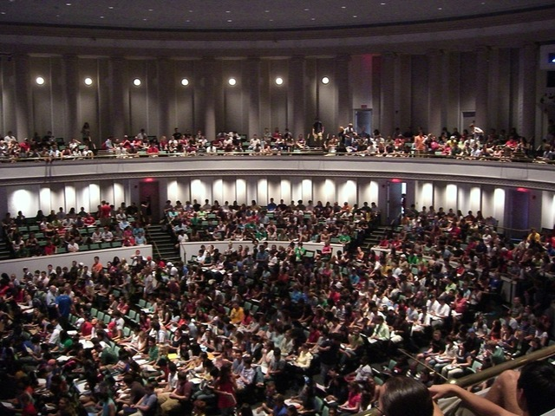
Bad smells in code
Large class

Slide 14
Bad smells in code
Large class
Too many different subparts and methods
Which means lack of ???
Two step solution:
Gather up the little pieces into aggregate subparts.
(Extract class, replace data value with object)
Delegate methods to the new subparts.
(Extract method)
Likely, you’ll notice some unnecessary subparts that have been hiding in the forest!

Slide 15
Bad smells in code
Large class
Counter example:
Library classes often have large, fat interfaces (many methods, many parameters, lots of overloading)
If the many methods exist for the purpose of flexibility, that’s OK in a library class.

Slide 16
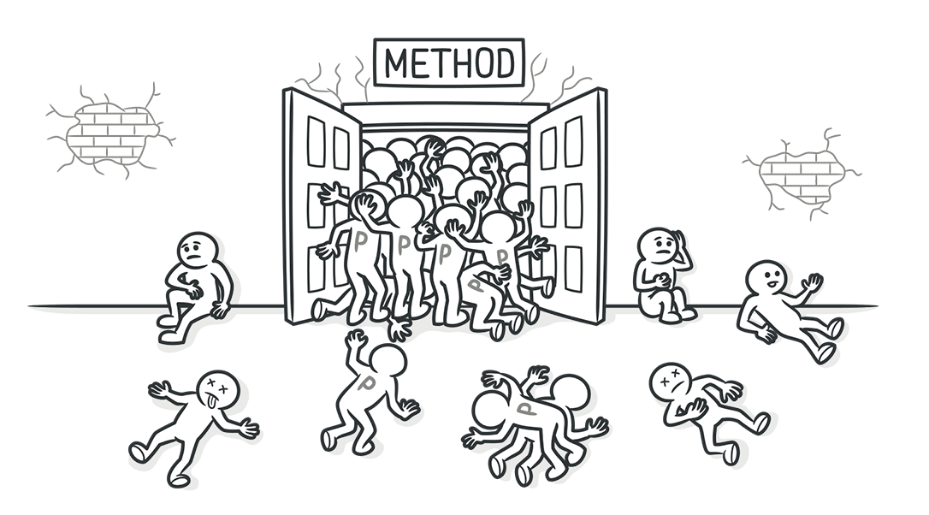
Bad smells in code
Long parameter list
More than three or four parameters for a method

Slide 17
Bad smells in code
Long parameter list
Long parameter lists make methods difficult for clients to understand
This is often a symptom of
Trying to do too much
with too many disparate subparts
In the old days, structured programming taught the use of parameterization as a cure for global variables.
With OOP, objects have mini-islands of state that can be reasonably treated as “global” to the methods (yet are still hidden from the rest of the program).

Slide 18
Bad smells in code
Solutions to Long Parameter List
Trying to do too much?
Break up into sub-tasks
(Extract method)
… with too many disparate subparts?
Gather up parameters into aggregate subparts
Your method interfaces will be much easier to understand!
(Preserve whole object, introduce parameter object)

Slide 19
Bad smells in code
Divergent change
Occurs when one class is commonly changed in different ways for different reasons
Likely, this class is trying to do too much and contains too many unrelated subparts
Similar to the code smell ???
Over time, some classes develop a “God Complex”
They acquires details/ownership of subparts that rightly belong elsewhere
This is a sign of poor cohesion
Unrelated elements in the same container
Solution:
Break it up, reshuffle, reconsider relationships and responsibilities (Extract class)

Slide 20
Bad smells in code
Shotgun Surgery
Each time you want to make a single, seemingly coherent change, you have to change lots of classes in little ways
Also a classic sign of poor cohesion
Related elements are not in the same container!
Solution:
Look to do some gathering, either in a new or existing class.
(Move method/field)

Slide 21
Bad smells in code
Feature envy
A method seems more interested in another class than the one it’s defined in
e.g., a method A::m() calls lots of get/set methods of class B
Solution:
Move m() (or part of it) into B!
(Move method/field, extract method)

Slide 22
Bad smells in code
Data Clumps
You see a set of variables that seem to “hang out” together
e.g., passed as parameters, changed/accessed at the same time
Usually, this means that there’s a coherent subobject just waiting to be recognized and encapsulated
void Scene::setTitle (string titleText,
int titleX, int titleY,
Colour titleColour){…}
void Scene::getTitle (string& titleText,
int& titleX, int& titleY,
Colour& titleColour){…}

Slide 23
Bad smells in code
Data Clumps
In the example, a Title class is dying to be born
If a client knows how to change a title’s x, y, text, and colour, then it knows enough to be able to “roll its own” Title objects.
However, this does mean that the client now has to talk to another class.
This will greatly shorten and simplify your parameter lists (which aids understanding) and makes your class conceptually simpler too.
(Preserve whole object, extract class, introduce parameter object)

Slide 24
Bad smells in code
Primitive Obsession
All subparts of an object are instances of primitive types
(int, string, bool, double, etc.)
e.g., dates, currency, SIN, tel.#, ISBN, special string values
Often, these small objects have interesting and non-trivial constraints that can be modelled
e.g., fixed number of digits/chars, check digits, special values
Solution:
Create some “small classes” that can validate and enforce the constraints.
(Replace data value with object, extract class, introduce parameter object)

Slide 25
Bad smells in code
Message chains
Client asks an object which asks a subobject, which asks a subobject, …
Multi-layer “drill down” may result in sub-sub-sub-objects being passed back to requesting client.
Sounds like the client already has an understanding of the structure of the object,even if it is going through appropriate intermediaries.
Probably need to rethink abstraction …
Why is a deeply nested subpart surfacing?
Why is the subpart so simple that it’s useful far from home?
(Hide delegate)

Slide 26
Bad smells in code
Data class
Class consists of (simple) data fields and simple get/set methods only.
Solution:
Have a look at usage patterns in the clients
Try to abstract some commonalities of usage into methods of the data class and move some functionality over
Data classes can be quite reasonable, if used judiciously.
In C++, often use structs to model data classes.
“Data classes are like children. They are OK as a starting point, but to participate as a grownup object, they need to take on some responsibility.”
(Extract/move method)

Slide 27
Bad smells in code
Comments
In the context of refactoring, Fowler claims that long comments are often a sign of opaque, complicated, inscrutable code.
They aren’t against comments so much as in favour of self-evident coding practices.
Rather than explaining opaque code, restructure it!
(Extract method/class, [many others applicable] …)
Comments are best used to document rationale
i.e., explain why you picked one approach over another.

Slide 28
Summary
Fowler et al.‘s Refactoring is a well-written book that summarizes a lot of “best practices” of OOD/OOP with nice examples.
Many books on OOD heuristics are vague and lack concrete advice.
Most of the advice in this book is aimed at low-level OO programming.
i.e., loops, variables, method calls, and class definitions.
Next obvious step up in abstraction/scale is to OODPs.
i.e., collaborating classes
This is an excellent book for the intermediate-level OO programmer.
Experienced OO programmers will have discovered a lot of the techniques already on their own.

Slide 29
Small Refactoring Techniques
Composing Methods
Extract Method
Inline Method
Inline Temp
Replace Temp with Query
Introduce Explaining Variable
Split Temporary Variable
Remove Assignments to Parameters
Replace Method with Method Object
Substitute Algorithm
Moving Features Between Objects
Move Method
Move Field
Extract Class
Inline Class
Hide Delegate
Remove Middle Man
Introduce Foreign Method
Introduce Local Extension......

Slide 30
Small Refactoring Techniques
Organizing Data
Self Encapsulate Field
Replace Data Value with Object
Change Value to Reference
Change Reference to Value
Replace Array with Object
Duplicate Observed Data
Change Unidirectional Association to Bidirectional
Change Bidirectional Association to Unidirectional
Replace Magic Number with Symbolic Constant
Encapsulate Field
Encapsulate Collection
Replace Record with Data Class
Replace Type Code with Class
Replace Type Code with Subclasses
Replace Type Code with State/Strategy
Replace Subclass with Fields
Simplifying Conditional Expressions
Decompose Conditional
Consolidate Conditional Expression
Consolidate Duplicate Conditional Fragments
Remove Control Flag
Replace Nested Conditional with Guard Clauses
Replace Conditional with Polymorphism
Introduce Null Object
Introduce Assertion

Slide 31
Small Refactoring Techniques
Making Method Calls Simpler
Rename Method
Add Parameter
Remove Parameter
Separate Query from Modifier
Parameterize Method
Replace Parameter with Explicit Methods
Preserve Whole Object
Replace Parameter with Method
Introduce Parameter Object
Remove Setting Method
Hide Method
Replace Constructor with Factory Method
Encapsulate Downcast
Replace Error Code with Exception
Replace Exception with Test
Dealing with Generalization
Pull Up Field
Pull Up Method
Pull Up Constructor Body
Push Down Method
Push Down Field
Extract Subclass
Extract Superclass
Extract Interface
Collapse Hierarchy
Form Template Method
Replace Inheritance with Delegation
Replace Delegation with Inheritance

Slide 32
Extract Method
void printOwing(double amount) {
printBanner();
//print details
System.out.println ("name:" + _name);
System.out.println ("amount" + amount);
}
You have a code fragment that can be grouped together.
Turn the fragment into a method whose name explains the purpose of the method.
void printOwing(double amount) {
printBanner();
printDetails(amount);
}
void printDetails (double amount) {
System.out.println ("name:" + _name);
System.out.println ("amount" + amount);
}

Slide 33
Extract Method
void printOwing() {
Enumeration e = _orders.elements();
double outstanding = 0.0;
// print banner
System.out.println ("*******************************");
System.out.println ("***** Customer Owes ******");
System.out.println ("*******************************");
// calculate outstanding
while (e.hasMoreElements()) {
Order each = (Order) e.nextElement();
outstanding += each.getAmount();
}
//print details
System.out.println ("name:" + _name);
System.out.println ("amount" + outstanding);
}
void printOwing() {
printBanner();
double outstanding = getOutstanding();
printDetails(outstanding);
}
void printBanner() {
// print banner
System.out.println ("*******************************");
System.out.println ("***** Customer Owes ******");
System.out.println ("*******************************");
}
double getOutstanding() {
Enumeration e = _orders.elements();
double outstanding = 0.0;
while (e.hasMoreElements()) {
Order each = (Order) e.nextElement();
outstanding += each.getAmount();
}
return outstanding;
}
void printDetails (double outstanding) {
System.out.println ("name:" + _name);
System.out.println ("amount" + outstanding);
}

Slide 34
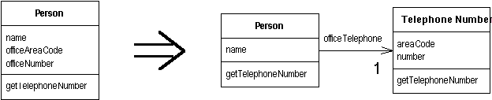
Extract class
You have one class doing work that should be done by two.
Create a new class and move the relevant fields and methods from the old class into the new class.

Slide 35
Extract class + Move Field
class TelephoneNumber {
String getAreaCode() {
return _areaCode;
}
void setAreaCode(String arg) {
_areaCode = arg;
}
private String _areaCode;
}
class Person...
private TelephoneNumber _officeTelephone = new TelephoneNumber();
public String getTelephoneNumber() {
return ("(" + getOfficeAreaCode() + ") " + _officeNumber);
}
String getOfficeAreaCode() {
return _officeTelephone.getAreaCode();
}
void setOfficeAreaCode(String arg) {
_officeTelephone.setAreaCode(arg);
}
class Person...
public String getName() {
return _name;
}
public String getTelephoneNumber() {
return ("(" + _officeAreaCode + ") " + _officeNumber);
}
String getOfficeAreaCode() {
return _officeAreaCode;
}
void setOfficeAreaCode(String arg) {
_officeAreaCode = arg;
}
String getOfficeNumber() {
return _officeNumber;
}
void setOfficeNumber(String arg) {
_officeNumber = arg;
}
private String _name;
private String _officeAreaCode;
private String _officeNumber;
Notes:
1- Move field

Slide 36
Extract Class + Move Method
class TelephoneNumber {
String getAreaCode() {
return _areaCode;
}
void setAreaCode(String arg) {
_areaCode = arg;
}
private String _areaCode;
}
class Person...
private TelephoneNumber _officeTelephone = new TelephoneNumber();
public String getTelephoneNumber() {
return ("(" + getOfficeAreaCode() + ") " + _officeNumber);
}
String getOfficeAreaCode() {
return _officeTelephone.getAreaCode();
}
void setOfficeAreaCode(String arg) {
_officeTelephone.setAreaCode(arg);
}
class TelephoneNumber...
public String getTelephoneNumber() {
return ("(" + _areaCode + ") " + _number);
}
String getAreaCode() {
return _areaCode;
}
void setAreaCode(String arg) {
_areaCode = arg;
}
String getNumber() {
return _number;
}
void setNumber(String arg) {
_number = arg;
}
private String _number;
private String _areaCode;
class Person...
public String getName() {
return _name;
}
public String getTelephoneNumber(){
return _officeTelephone.getTelephoneNumber();
}
private String _name;
private TelephoneNumber _officeTelephone =
new TelephoneNumber();
Notes:
Move Method

Slide 37
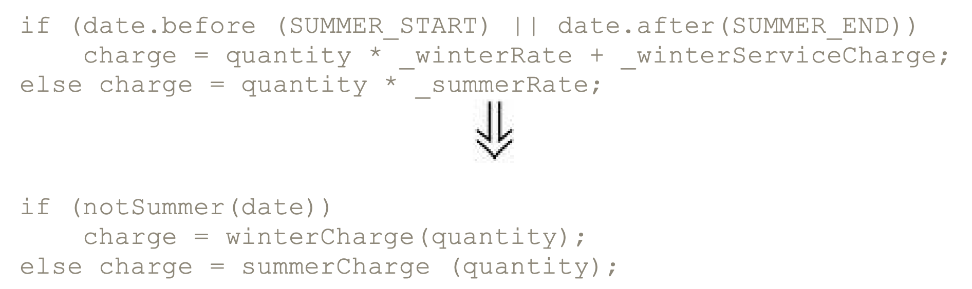
Decompose Conditional
You have a complicated conditional (if-then-else) statement.
Extract methods from the condition, then part, and else parts.

Slide 38
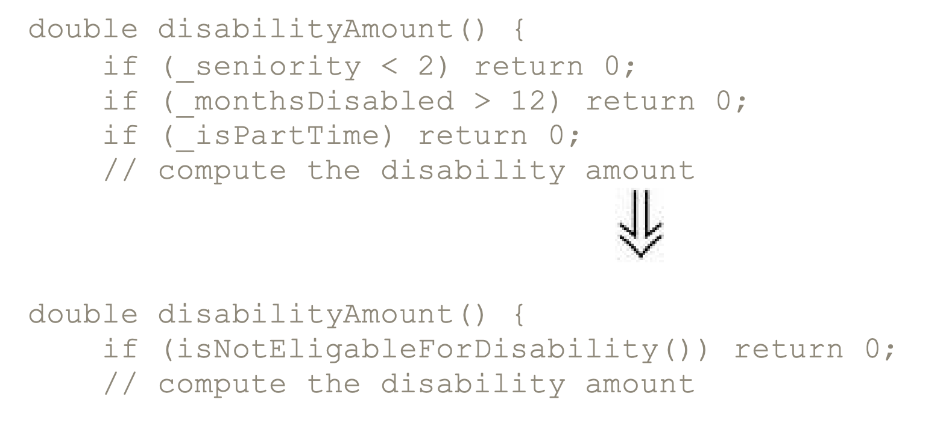
Consolidate Conditional Expression
You have a sequence of conditional tests with the same result.
Combine them into a single conditional expression and extract it.

Slide 39
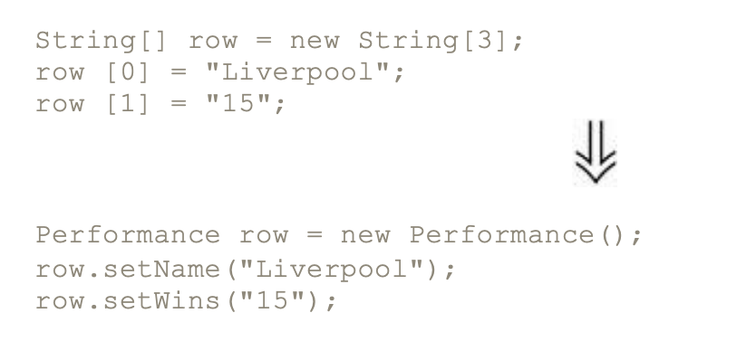
Replace Array with Object
You have an array in which certain elements mean different things.
Replace the array with an object that has a field for each element.

Slide 40
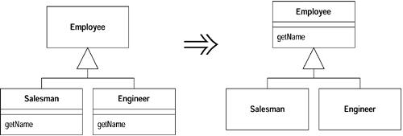
Pull Up Method
You have methods with identical results on subclasses.
Move them to the superclass.

Slide 41
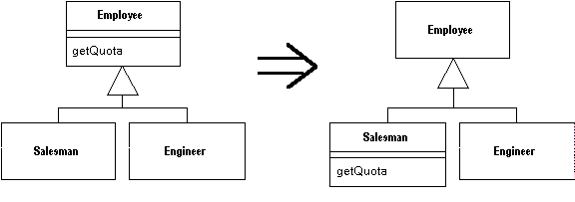
Push Down Method
Behavior on a superclass is relevant only for some of its subclasses.
Move it to those subclasses.

Slide 42
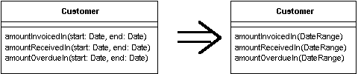
Introduce Parameter Object
You have a group of parameters that naturally go together.
Replace them with an object.

Slide 43
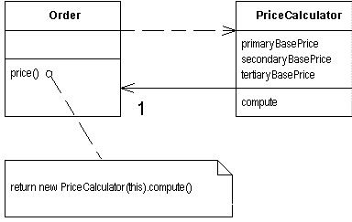
Replace Method with Method Object
You have a long method that uses local variables in such a way that you cannot apply Extract Method
Turn the method into its own object so that all the local variables become fields on that object. You can then decompose the method into other methods on the same object.
class Order...
double price() {
double primaryBasePrice;
double secondaryBasePrice;
double tertiaryBasePrice;
// long computation;
...
}

Slide 44

Preserve Whole Object
You are getting several values from an object and passing these values as parameters in a method call
Send the whole object instead
int low = daysTempRange.getLow();
int high = daysTempRange.getHigh();
withinPlan = plan.withinRange(low, high);
withinPlan = plan.withinRange(daysTempRange);

Slide 45
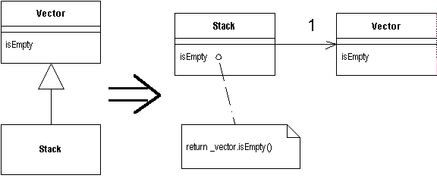
Replace Inheritance with Delegation
subclass uses only part of a superclasses interface or does not want to inherit data.
Create a field for the superclass, adjust methods to delegate to the superclass,
and remove the subclassing.

Slide 46
Big Refactoring
Tease apart inheritance
Extract hierarchy
Convert procedural design to objects
Separate domain from presentation

Slide 47
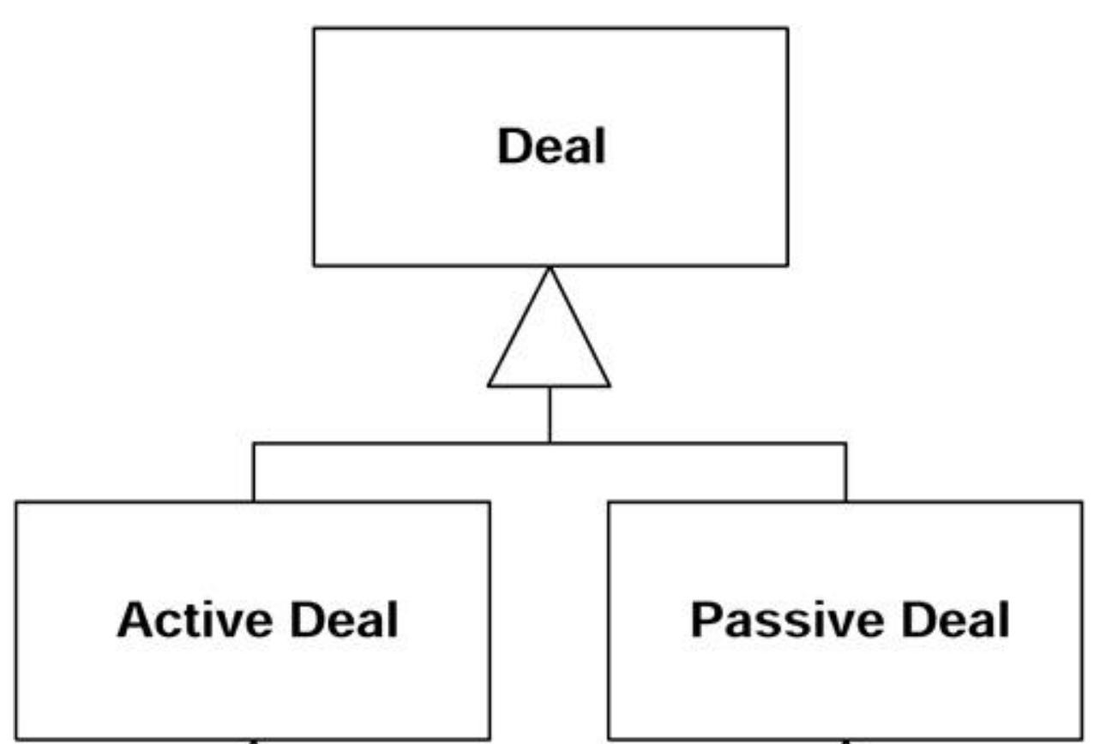
Big Refactoring Tease apart inheritance
You have an inheritance hierarchy that is doing two jobs at once.
Create two hierarchies and use delegation to invoke one from the other.

Slide 48
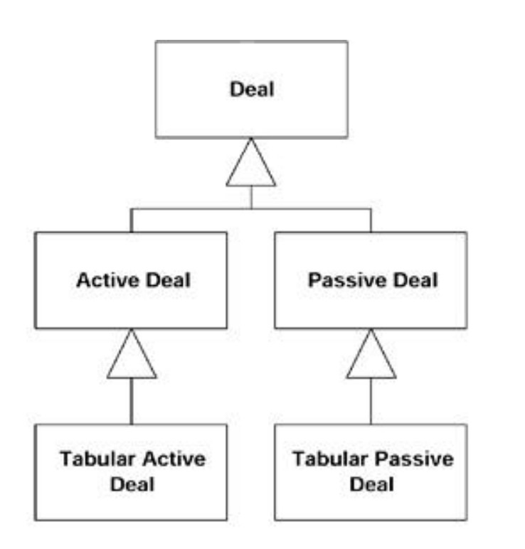
Big Refactoring Tease apart inheritance

Slide 49
Big Refactoring Tease apart inheritance

Slide 50
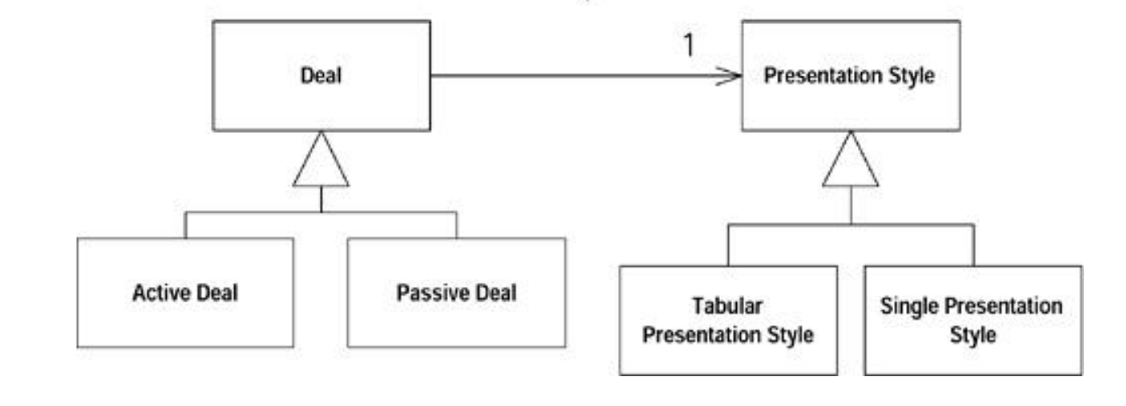
Big Refactoring Tease apart inheritance

Slide 51
Big Refactoring Extract Hierarchy
You have a class that is doing too much work, at least in part through many conditional statements.
Create a hierarchy of classes in which each subclass represents a special case

Slide 52
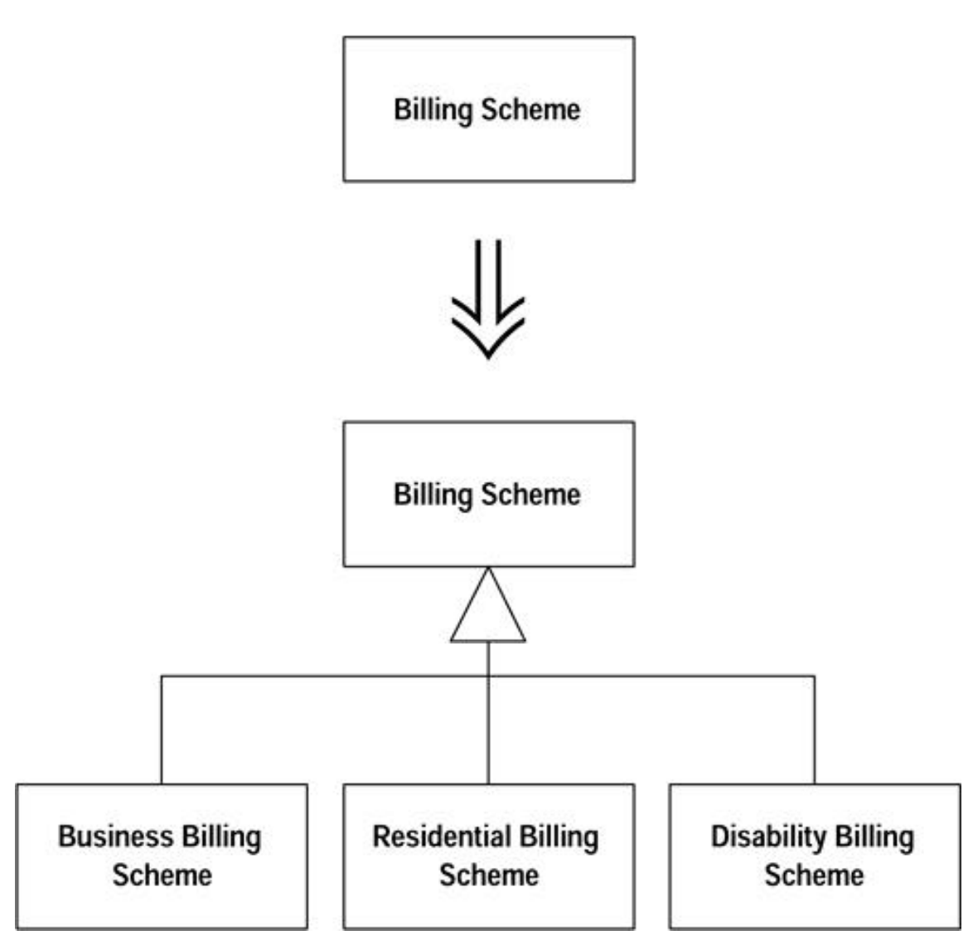
Big Refactoring Extract Hierarchy

Slide 53
Big Refactoring Extract Hierarchy

Slide 54
Big Refactoring Convert Procedural Design to Objects
You have code written in a procedural style.
Turn the data records into objects, break up the behavior, and move the behavior to the objects.

Slide 55
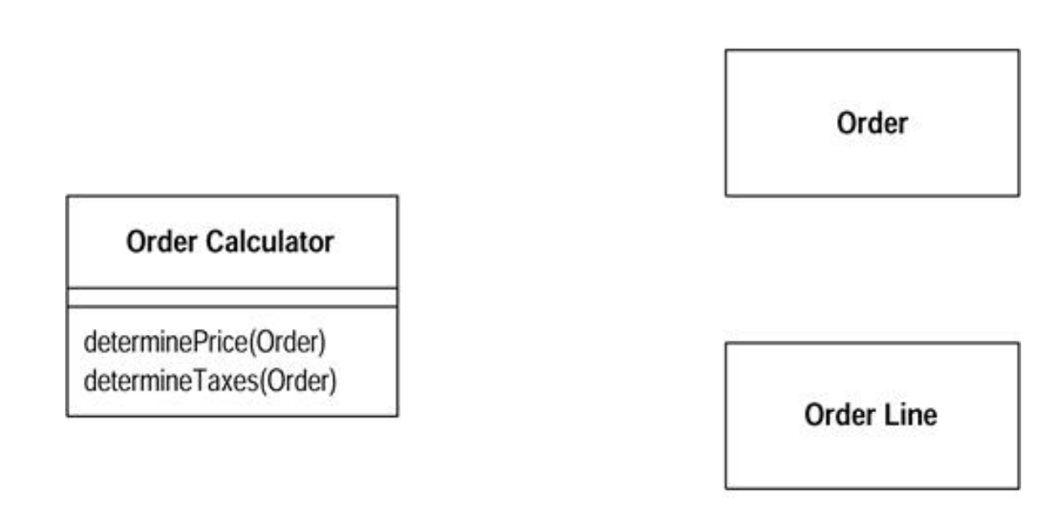
Big Refactoring Convert Procedural Design to Objects

Slide 56
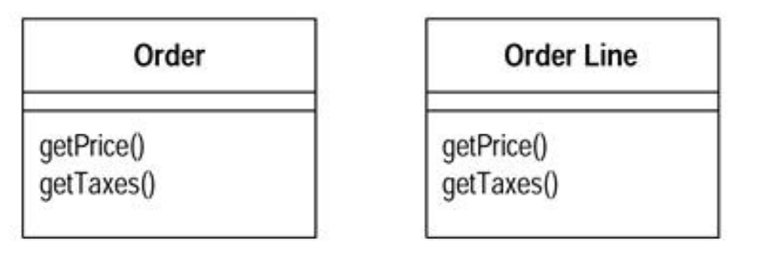
Big Refactoring Convert Procedural Design to Objects

Slide 57
Why Are Developers Reluctant To Refactor Code?
Even after buying into the advantages of refactoring, you might not do it !!!!
You might not understand how to refactor
If the benefits are long term, why exert the effort now?
Refactoring code is an overhead activity
“Refactoring is an overhead activity, I’m paid to write new, revenue-generating features”
Refactoring might break existing programs

Slide 58
Reducing the overhead of Refactoring
Tools and technologies are available to allow refactoring to be done quickly and relatively painlessly
Experienced Object-Oriented programmers suggest that overhead is compensated by time saved later on
Might seem awkward at first, but starts feeling like an essential once you incorporate it into the cycle

Slide 59
Sources
These Slides are partly adopted from the lecture notes of Prof. Michael Godfrey on Object Oriented Programming
Refactoring: Improving the Design of Existing Code, by Martin Fowler (et al.),1999, Addison-Wesley
www.refactoring.com/catalog/index.html
https://refactoring.guru/

